Slide 1
CS4104 Applied Machine Learning
Clustering: Un Supervised Learning

Slide 2
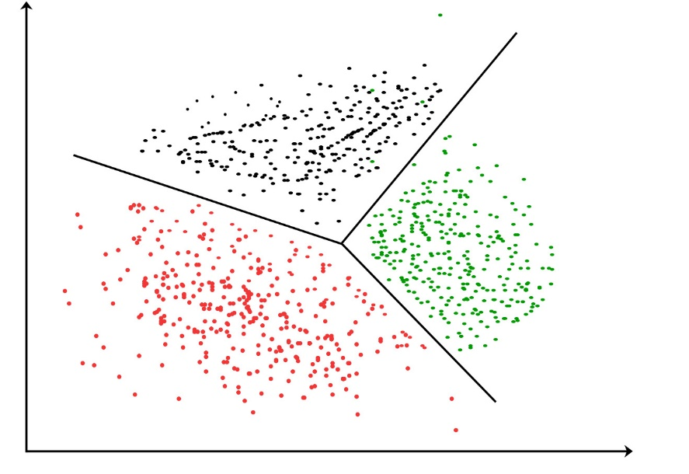
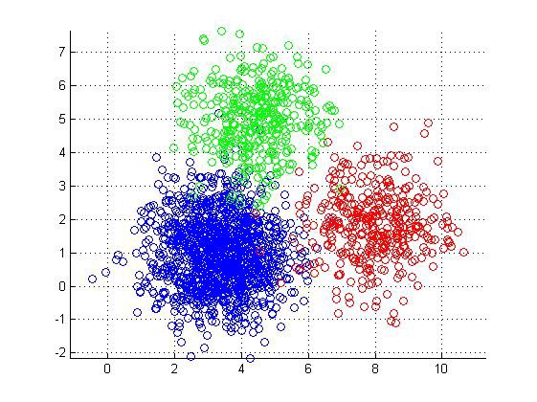
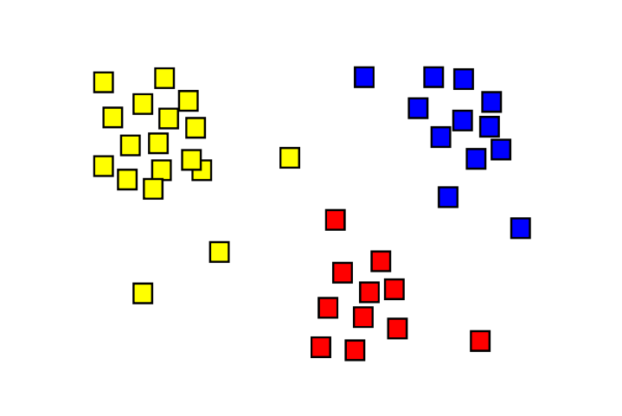
Clustering
The organization of unlabeled data into similarity groups called clusters.
A cluster is a collection of data items which are “similar” between them, and “dissimilar” to data items in other clusters.

Slide 3
History
John Snow (London Physician) plotted the location of cholera deaths on a map during an outbreak in 1850s.
The location indicated that the cases were clustered around certain intersections where there were polluted wells that leaded to the solution.

Slide 4
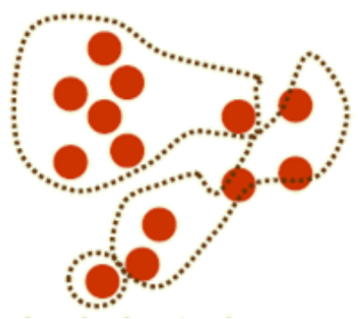
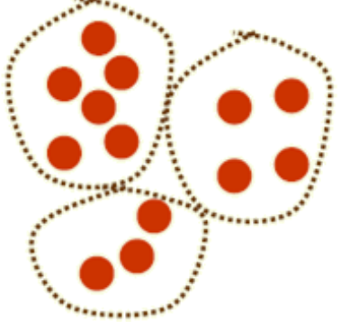
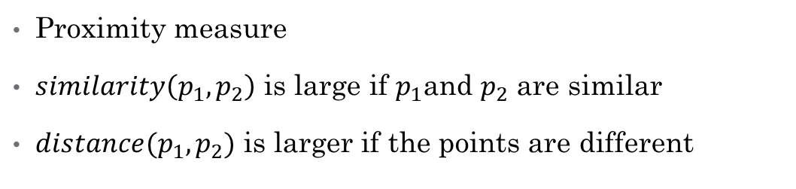
Good cluster
Clustering measure
Proximity measure
$similarity\left(p_{1},p_{2}\right)$ is large if $p_{1}$and $p_{2}$ are similar
$distance(p_{1},p_{2})$ is larger if the points are different
Bad cluster

Slide 5
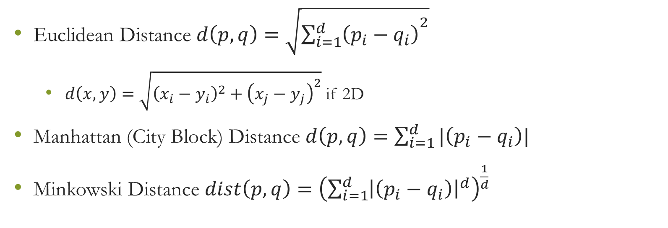
Distance Measure
Euclidean Distance $d\left(p,q\right)=\sqrt{{\sum_{i=1}^{d}{\left(p_{i}−q_{i}\right)}}^{2}}$
$d\left(x,y\right)=\sqrt{{\left(x_{i}−y_{i}\right)}^{2}+{\left(x_{j}−y_{j}\right)}^{2}}$ if 2D
Manhattan (City Block) Distance $d\left(p,q\right)=\sum_{i=1}^{d}{|\left(p_{i}−q_{i}\right)|}$
Minkowski Distance $dist\left(p,q\right)={\left(\sum_{i=1}^{d}{{\left|\left(p_{i}−q_{i}\right)\right|}^{d}}\right)}^{\frac{1}{d}}$

Slide 6
Cluster evaluation
Intra-cluster cohesion (compactness)
Cohesion measures how near the data points in a cluster are to the cluster centroid.
Sum of squared error (SSE) is a commonly used measure.
Inter-cluster separation (isolation)
Separation means that different cluster centroids should be far away from one another.
In most applications, expert judgments are still the key

Slide 7
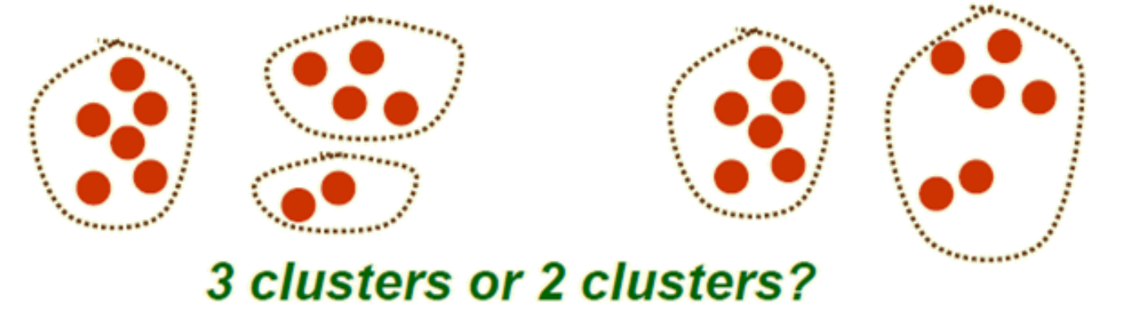
Number of clusters?

Slide 8
Number of Clusters?
Fix number of clusters
Vitiate number of clusters
Best number of clusters

Slide 9
Clustering techniques
Divisive/Top-Down
K-Means
Agglomerative/Bottom-Up
Centroid
Hierarchical
Model Based
Partitional
clustering
Graph Theoretic
Decision Based
Spectral
Bayesian
Non-Parametric

Slide 10
Clustering techniques
K-Means
Hierarchical
Centroid
Partitional
clustering
Bayesian

Slide 11
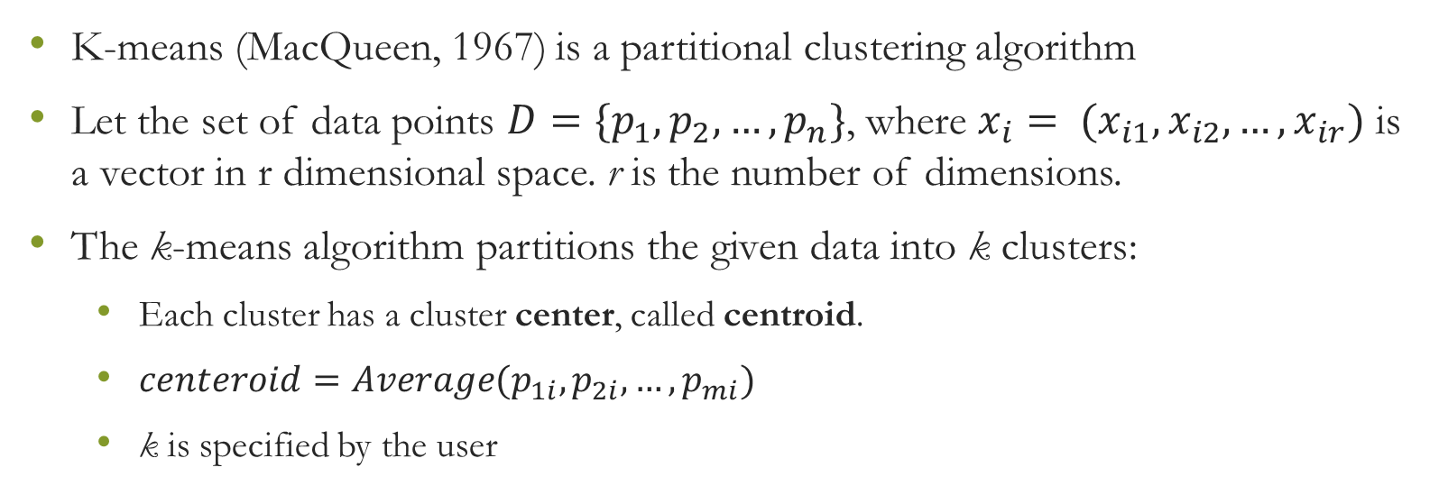
K-Means clustering
K-means (MacQueen, 1967) is a partitional clustering algorithm
Let the set of data points $D=\{p_{1}, p_{2}, …, p_{n}\}$, where $x_{i}= (x_{i1}, x_{i2}, …, x_{ir})$ is a vector in r dimensional space. r is the number of dimensions.
The k-means algorithm partitions the given data into k clusters:
Each cluster has a cluster center, called centroid.
$centeroid=Average(p_{1i},p_{2i},…,p_{mi})$
k is specified by the user

Slide 12
K-means Clustering
Given k, the k-means algorithm works as follows:
Choose k (random) data points (seeds) to be the initial centroids, cluster centers
Assign each data point to the closest centroid
Re-compute the centroids using the current cluster memberships
If a convergence criterion is not met, repeat steps 2 and 3

Slide 13
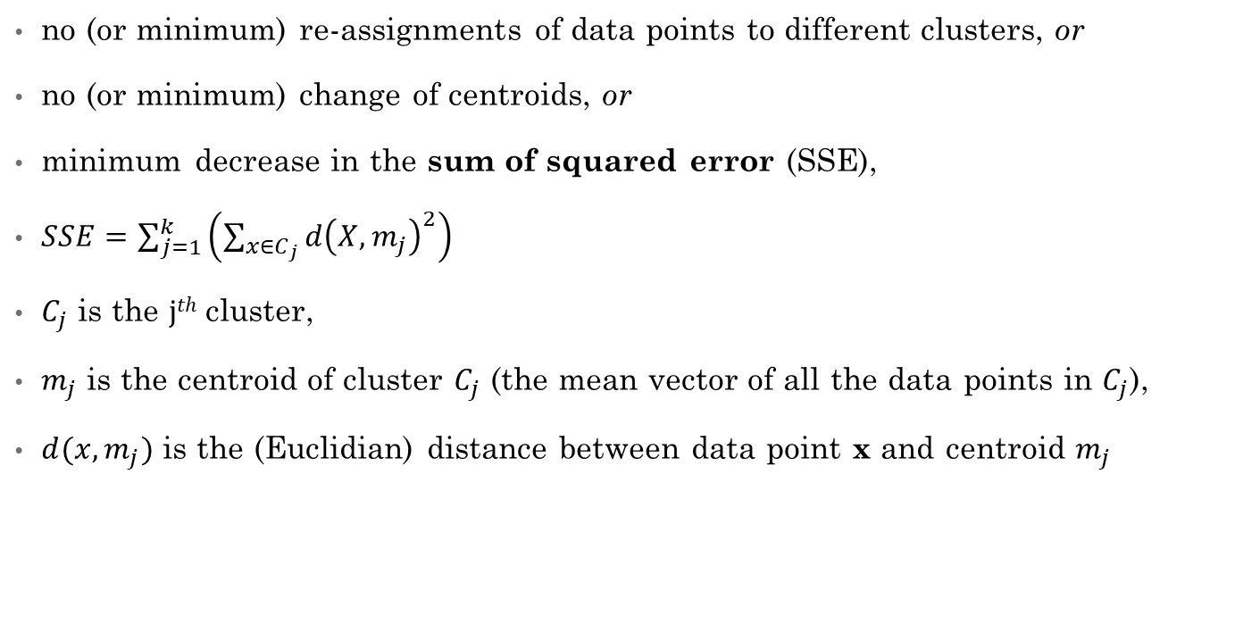
K-means convergence (stopping) criterion
no (or minimum) re-assignments of data points to different clusters, or
no (or minimum) change of centroids, or
minimum decrease in the sum of squared error (SSE),
$SSE=\sum_{j=1}^{k}{\left(\sum_{x∈C_{j}}{d{\left(X,m_{j}\right)}^{2}}\right)}$
$C_{j}$ is the $jth$cluster,
$m_{j}$ is the centroid of cluster $C_{j}$ (the mean vector of all the data points in $C_{j}$),
$d(x, m_{j})$ is the (Euclidian) distance between data point x and centroid $m_{j}$

Slide 14
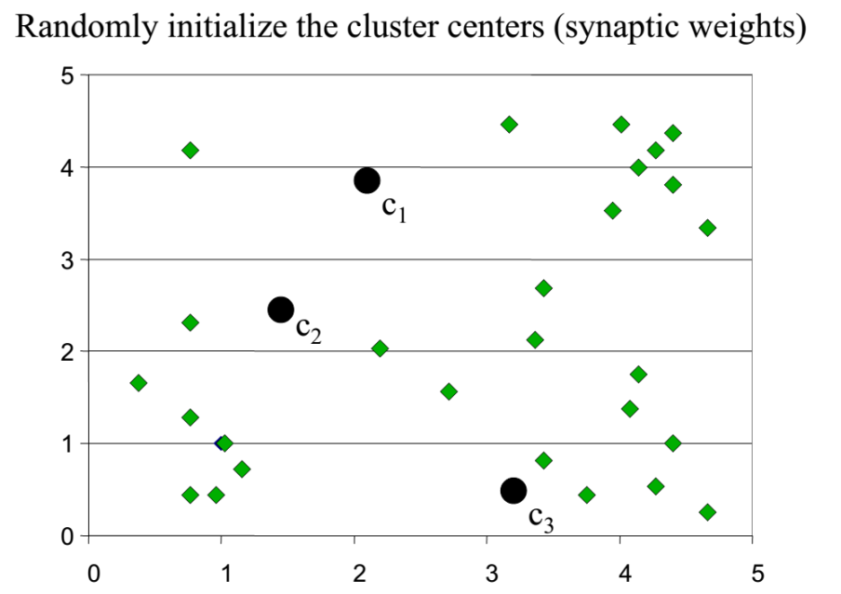
K-means clustering example

Slide 15
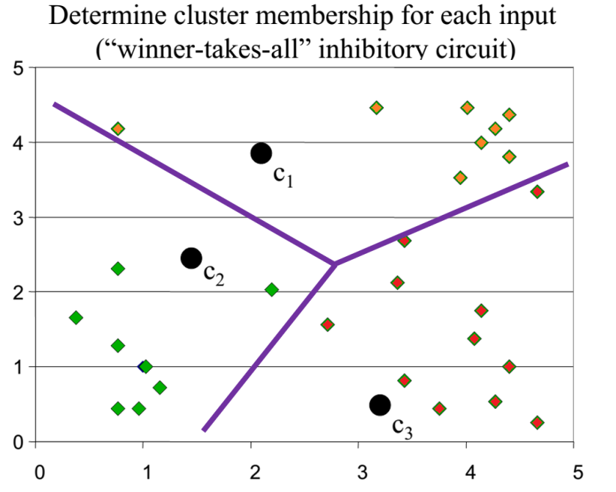
K-means clustering example

Slide 16
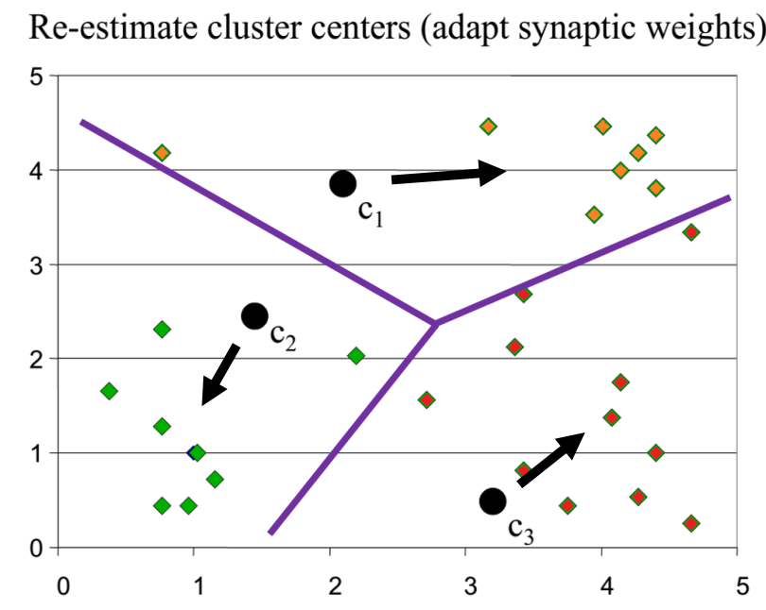
K-means clustering example

Slide 17
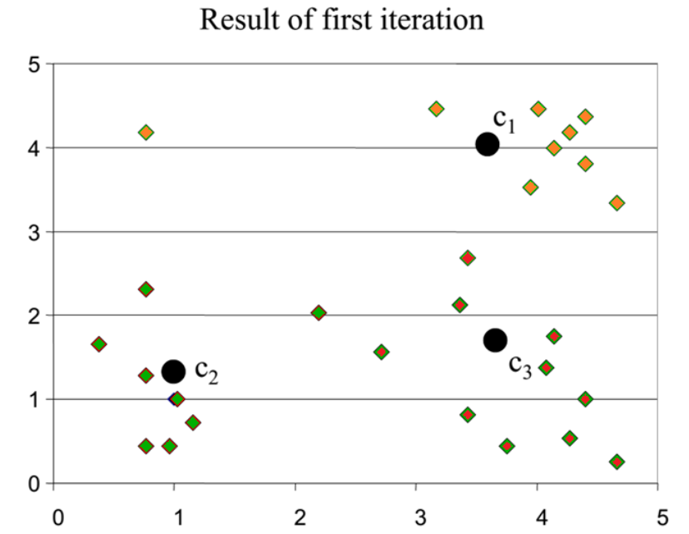
K-means clustering example

Slide 18
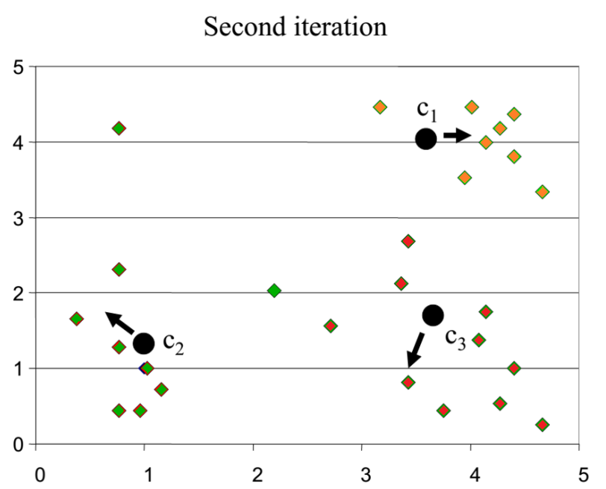
K-means clustering example

Slide 19
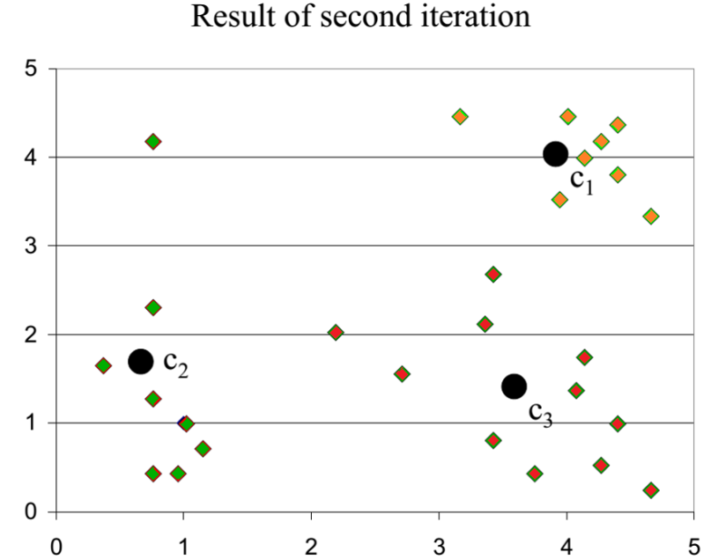
K-means clustering example

Slide 20
K-Means Analysis
Strengths
Weaknesses
Simple: easy to understand and to implement
Efficient: Time complexity: O(tkn),
where n is the number of data points,
k is the number of clusters, and
t is the number of iterations.
Since both k and t are small. k-means is considered a linear algorithm.
K-means is the most popular clustering algorithm.
Note that: it terminates at a local optimum if SSE is used.
The global optimum is hard to find due to complexity
The algorithm is only applicable if the mean is defined.
For categorical data, k-mode - the centroid is represented by most frequent values.
The user needs to specify k.
The algorithm is sensitive to outliers
Outliers are data points that are very far away from other data points.
Outliers could be errors in the data recording or some special data points with very different values.
No clear evidence that any other clustering algorithm performs better in general

Slide 21
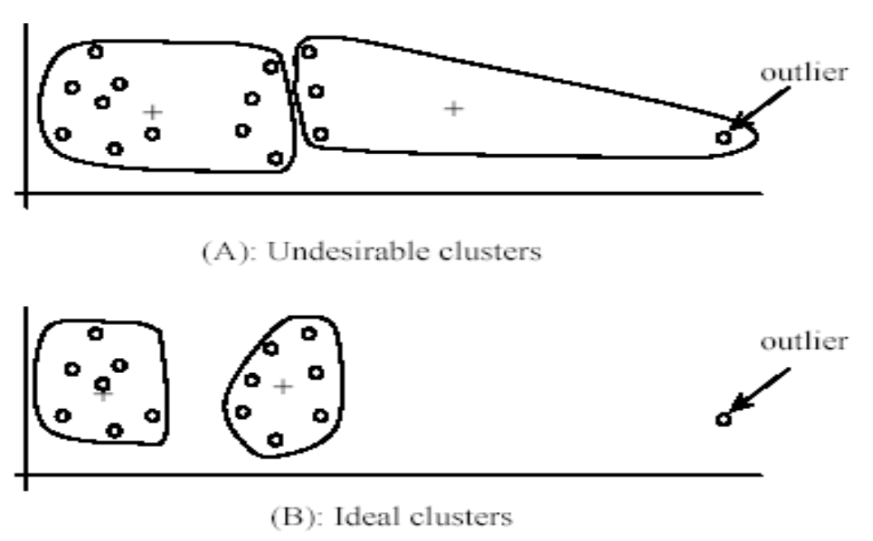

Slide 22
Outliers: Handling
Remove some data points that are much further away from the centroids than other data points
To be safe, we may want to monitor these possible outliers over a few iterations and then decide to remove them.
Perform random sampling: by choosing a small subset of the data points, the chance of selecting an outlier is much smaller
Assign the rest of the data points to the clusters by distance or similarity comparison, or classification

Slide 23
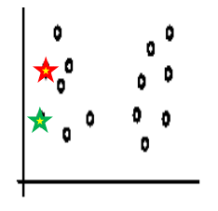
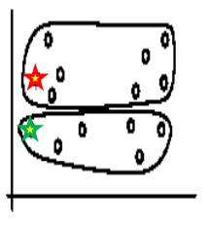
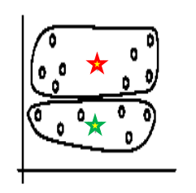
Sensitivity to initial seeds
Initial seeds
Iteration 1
Iteration 2

Slide 24
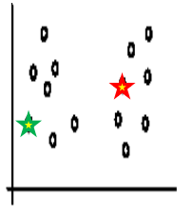
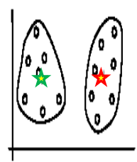
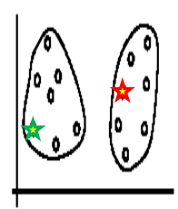
Sensitivity to initial seeds
Initial seeds
Iteration 1
Iteration 2

Slide 25
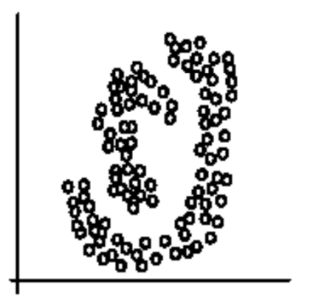
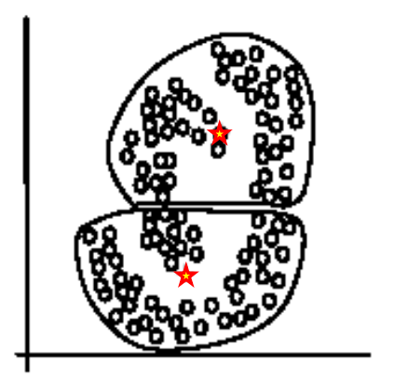
Sensitivity to initial seeds
Two Clusters
K-Mean Clusters

Slide 26
CS4104 Applied Machine Learning
Density Based Clustering

Slide 27
Density-based Approaches
Why Density-Based Clustering methods?
Discover clusters of arbitrary shape.
Clusters – Dense regions of objects separated by regions of low density
DBSCAN – the first density based clustering
OPTICS – density based cluster-ordering
DENCLUE – a general density-based description of cluster and clustering

Slide 28
DBSCAN: Density Based Spatial Clustering of Applications with Noise
Proposed by Ester, Kriegel, Sander, and Xu (KDD96)
Relies on a density-based notion of cluster: A cluster is defined as a maximal set of density-connected points.
Discovers clusters of arbitrary shape in spatial databases with noise

Slide 29
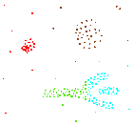
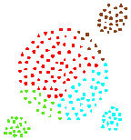
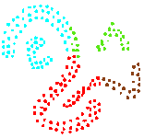
Density-Based Clustering
Basic Idea:
Clusters are dense regions in the data space, separated by regions of lower object density
Why Density-Based Clustering?
Results of a k-medoid algorithm for k=4
Different density-based approaches exist (see Textbook & Papers) Here we discuss the ideas underlying the DBSCAN algorithm

Slide 30
Density Based Clustering: Basic Concept
Intuition for the formalization of the basic idea
For any point in a cluster, the local point density around that point has to exceed some threshold
The set of points from one cluster is spatially connected
Local point density at a point p defined by two parameters
ε – radius for the neighborhood of point p: N_{ε} (p) := {q in data set D | dist(p, q) ≤ ε}
MinPts – minimum number of points in the given neighbourhood N(p)

Slide 31
ε-Neighborhood
ε-Neighborhood – Objects within a radius of ε from an object.
“High density” - ε-Neighborhood of an object contains at least MinPts of objects.
ε-Neighborhood of p
ε
ε
ε-Neighborhood of q
q
p
Density of p is “high” (MinPts = 4)
Density of q is “low” (MinPts = 4)

Slide 32
Core, Border & Outlier
Outlier
Given ε and MinPts, categorize the objects into three exclusive groups.
Border
A point is a core point if it has more than a specified number of points (MinPts) within Eps These are points that are at the interior of a cluster.
A border point has fewer than MinPts within Eps, but is in the neighborhood of a core point.
A noise point is any point that is not a core point nor a border point.
Core
ε = 1unit, MinPts = 5

Slide 33
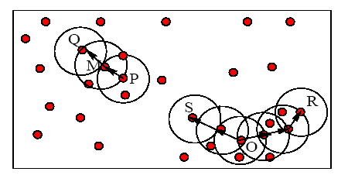
Example
M, P, O, and R are core objects since each is in an Eps neighborhood containing at least 3 points
Minpts = 3
Eps=radius of the circles

Slide 34
Density-Reachability
Directly density-reachable
An object q is directly density-reachable from object p if p is a core object and q is in p’s ε-neighborhood.
q is directly density-reachable from p
p is not directly density- reachable from q?
Density-reachability is asymmetric.
ε
ε
q
p
MinPts = 4

Slide 35
Density-reachability
Density-Reachable (directly and indirectly):
A point p is directly density-reachable from p2;
p2 is directly density-reachable from p1;
p1 is directly density-reachable from q;
p←p2←p1←q form a chain.
p
p is (indirectly) density-reachable from q
q is not density- reachable from p?
p₂
p₁
q
MinPts = 7

Slide 36
Density-Connectivity
Density-reachable is not symmetric
not good enough to describe clusters
Density-Connected
A pair of points p and q are density-connected if they are commonly density-reachable from a point o.
Density-connectivity is symmetric
p
q
o

Slide 37
Formal Description of Cluster
Given a data set D, parameter ε and threshold MinPts.
A cluster C is a subset of objects satisfying two criteria:
Connected:  p,q C: p and q are density-connected.
Maximal:  p,q: if p C and q is density-reachable from p, then q C. (avoid redundancy)
P is a core object.

Slide 38
Review of Concepts
Is an object o in a cluster or an outlier?
Are objects p and q in the same cluster?
Are p and q density-connected?
Is o a core object?
Is o density-reachable by some core object?
Are p and q density-reachable by some object o?
Directly density-reachable
Indirectly density-reachable through a chain

Slide 39
DBSCAN Algorithm
Input: The data set D
Parameter: ε, MinPts
For each object p in D
if p is a core object and not processed then
C = retrieve all objects density-reachable from p
mark all objects in C as processed
report C as a cluster
else mark p as outlier
end if
End For
DBScan Algorithm

Slide 40
DBSCAN: The Algorithm
Arbitrary select a point p
Retrieve all points density-reachable from p wrt Eps and MinPts.
If p is a core point, a cluster is formed.
If p is a border point, no points are density-reachable from p and DBSCAN visits the next point of the database.
Continue the process until all of the points have been processed.

Slide 41
DBSCAN Algorithm: Example
Parameter
ε = 2 cm
MinPts = 3
for each o ∈ D do if o is not yet classified then if o is a core-object then collect all objects density-reachable from o and assign them to a new cluster. else assign o to NOISE

Slide 42
DBSCAN Algorithm: Example
Parameter
ε = 2 cm
MinPts = 3
for each o ∈ D do if o is not yet classified then if o is a core-object then collect all objects density-reachable from o and assign them to a new cluster. else assign o to NOISE

Slide 43
DBSCAN Algorithm: Example
Parameter
ε = 2 cm
MinPts = 3
for each o ∈ D do if o is not yet classified then if o is a core-object then collect all objects density-reachable from o and assign them to a new cluster. else assign o to NOISE

Slide 44
MinPts = 5
ε
P₁
ε
ε
C₁
P
P
C₁
C₁
1. Check the ε-neighborhood of p;
2. If p has less than MinPts neighbors then mark p as outlier and continue with the next object
3. Otherwise mark p as processed and put all the neighbors in cluster C
1. Check the unprocessed objects in C
2. If no core object, return C
3. Otherwise, randomly pick up one core object p₁, mark p₁ as processed, and put all unprocessed neighbors of p₁ in cluster C

Slide 45
ε
ε
C₁
C₁
ε
ε
ε
C₁
C₁
C₁

Slide 46
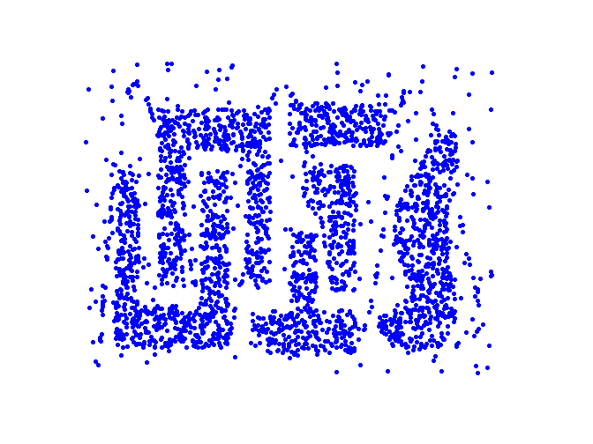
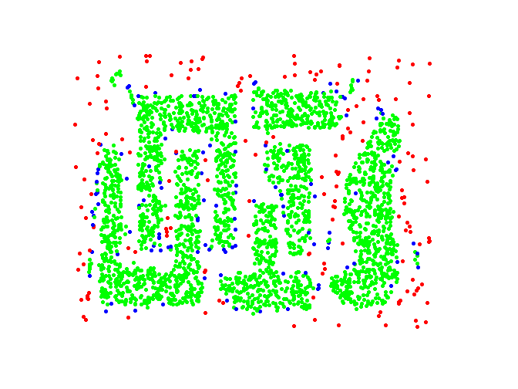
Example
Original Points
Point types: core, border and outliers
ε = 10, MinPts = 4

Slide 47
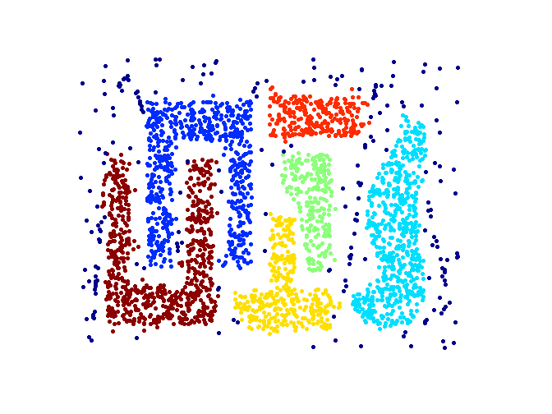
When DBSCAN Works Well
Original Points
Clusters
Resistant to Noise
Can handle clusters of different shapes and sizes

Slide 48
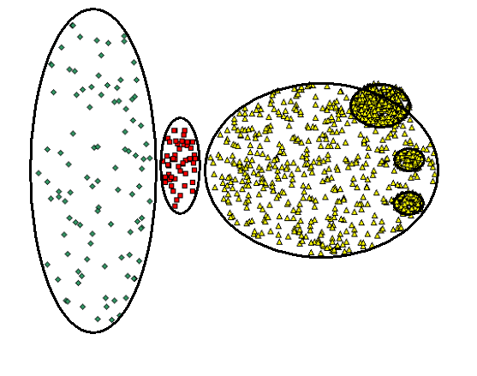
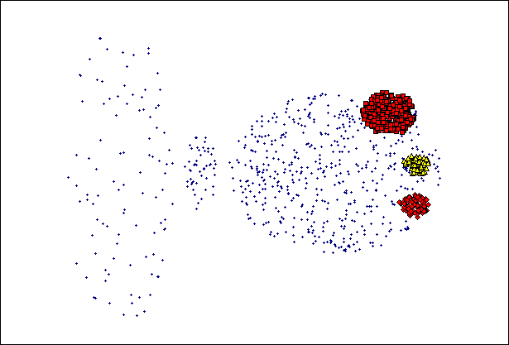
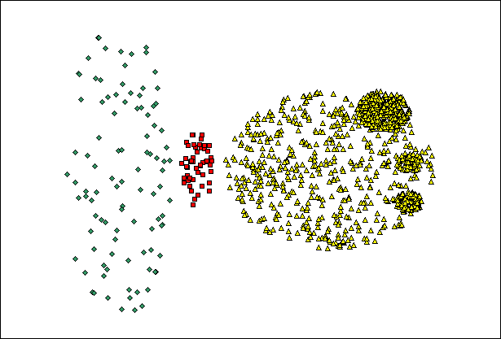
When DBSCAN Does NOT Work Well
(MinPts=4, Eps=9.92).
Original Points
Cannot handle Varying densities
sensitive to parameters
(MinPts=4, Eps=9.75)

Slide 49
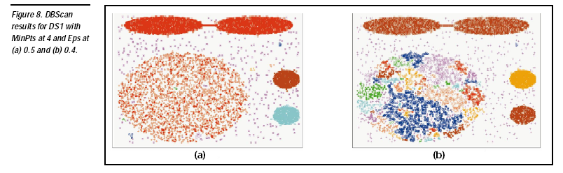

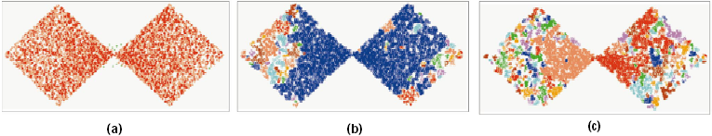
DBSCAN: Sensitive to Parameters

Slide 50
Determining the Parameters ε and MinPts
Cluster: Point density higher than specified by ε and MinPts
Idea: use the point density of the least dense cluster in the data set as parameters – but how to determine this?
Heuristic: look at the distances to the k-nearest neighbors
Function k-distance(p): distance from p to the its k-nearest neighbor
k-distance plot: k-distances of all objects, sorted in decreasing order
p
3-distance(p) :
q
3-distance(q) :

Slide 51
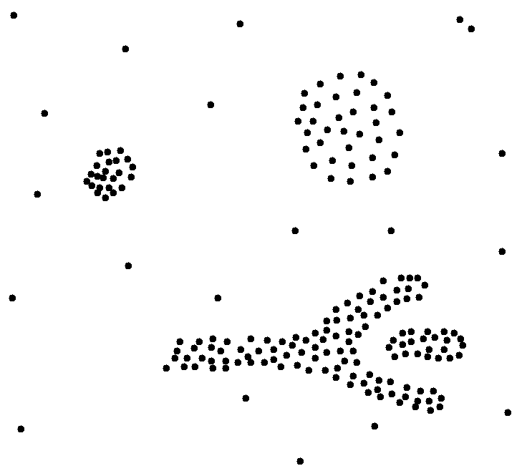
Determining the Parameters ε and MinPts
Example k-distance plot
Heuristic method:
Fix a value for MinPts (default: 2 × d –1)
User selects “border object” o from the MinPts-distance plot; ε is set to MinPts-distance(o)
3-distance
first „valley“
Objects
„border object“

Slide 52
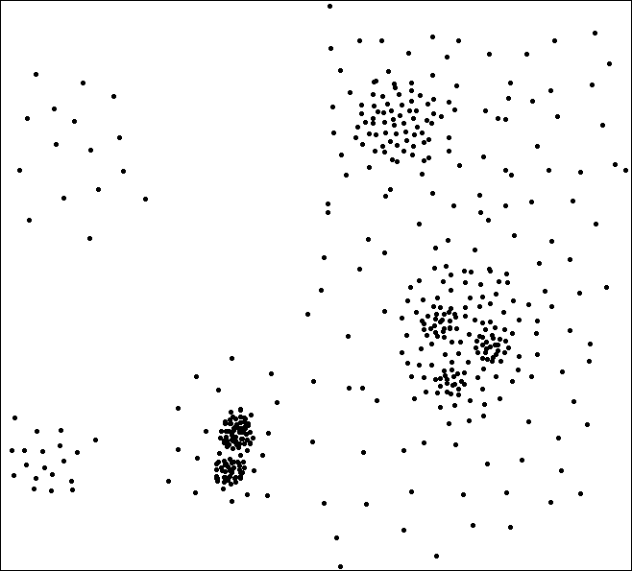
Determining the Parameters ε and MinPts
Problematic example
A
C
F
E
A, B, C
B, D, E
G
3-Distance
B‘, D‘, F, G
G1
G3
D1, D2,
G1, G2, G3
B
D
G2
D’
B’
D1
Objects
D2

Slide 53
Density Based Clustering: Discussion
Advantages
Clusters can have arbitrary shape and size
Number of clusters is determined automatically
Can separate clusters from surrounding noise
Can be supported by spatial index structures
Disadvantages
Input parameters may be difficult to determine
In some situations very sensitive to input parameter setting

Slide 54
OPTICS: Ordering Points To Identify the Clustering Structure
DBSCAN
Input parameter – hard to determine.
Algorithm very sensitive to input parameters.
OPTICS – Ankerst, Breunig, Kriegel, and Sander (SIGMOD’99)
Based on DBSCAN.
Does not produce clusters explicitly.
Rather generate an ordering of data objects representing density-based clustering structure.

Slide 55
OPTICS con’t
Produces a special order of the database wrt its density-based clustering structure
This cluster-ordering contains info equiv to the density-based clusterings corresponding to a broad range of parameter settings
Good for both automatic and interactive cluster analysis, including finding intrinsic clustering structure
Can be represented graphically or using visualization techniques

Slide 56
Density-Based Hierarchical Clustering
Observation: Dense clusters are completely contained by less dense clusters
Idea: Process objects in the “right” order and keep track of point density in their neighborhood
C
D
C
1
C
2

Slide 57
Core- and Reachability Distance
Parameters: “generating” distance ε, fixed value MinPts
core-distance_{ε,MinPts}(o)
“smallest distance such that o is a core object” (if that distance is ≤ ε ; “?” otherwise)
reachability-distance_{ε,MinPts}(p, o)
“smallest distance such that p is
directly density-reachable from o” (if that distance is ≤ ε ; “?” otherwise)
MinPts = 5
p
o
ε
q
core-distance(o)
reachability-distance(p,o)
reachability-distance(q,o)

Slide 58
OPTICS: Extension of DBSCAN
Order points by shortest reachability distance to guarantee that clusters w.r.t. higher density are finished first. (for a constant MinPts, higher
density requires lower ε)

Slide 59

The Algorithm OPTICS
Basic data structure: controlList
Memorize shortest reachability distances seen so far (“distance of a jump to that point”)
Visit each point
Make always a shortest jump
Output:
order of points
core-distance of points
reachability-distance of points

Slide 60
The Algorithm OPTICS
ControlList ordered by reachability-distance.
ControlList
cluster-ordered file
≥
foreach o ∈ Database // initially, o.processed = false for all objects o if o.processed = false; insert (o, “?”) into ControlList; while ControlList is not empty select first element (o, r-dist) from ControlList; retrieve N_{ε}(o) and determine c_dist= core-distance(o); set o.processed = true; write (o, r_dist, c_dist) to file; if o is a core object at any distance ≤ ε foreach p ∈ N_{ε}(o) not yet processed; determine r_dist_{p} = reachability-distance(p, o); if (p, _) ∉ ControlList insert (p, r_dist_{p}) in ControlList; else if (p, old_r_dist) ∈ ControlList and r_dist_{p} < old_r_dist update (p, r_dist_{p}) in ControlList;
database

Slide 61
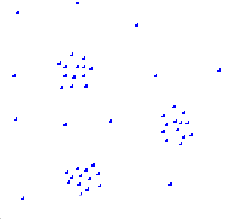
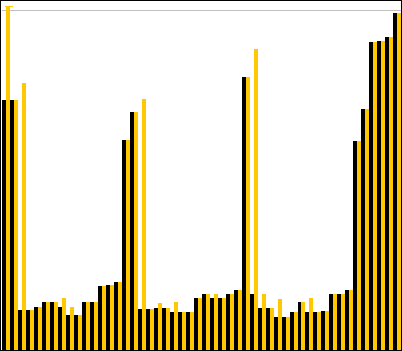
OPTICS: Properties
“Flat” density-based clusters wrt. ε* ≤ ε and MinPts afterwards:
Starts with an object o where c-dist(o) ≤ ε* and r-dist(o) > ε*
Continues while r-dist ≤ ε*
Performance: approx. runtime( DBSCAN(ε, MinPts) )
O( n * runtime(ε-neighborhood-query) )
without spatial index support (worst case): O( n² )
e.g. tree-based spatial index support: O( n ∗ log(n) )
1
2
17
3
16
18
3
1
4
4
2
16
17
18
Core-distance
Reachability-distance

Slide 62
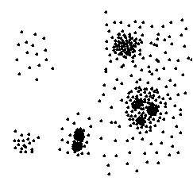
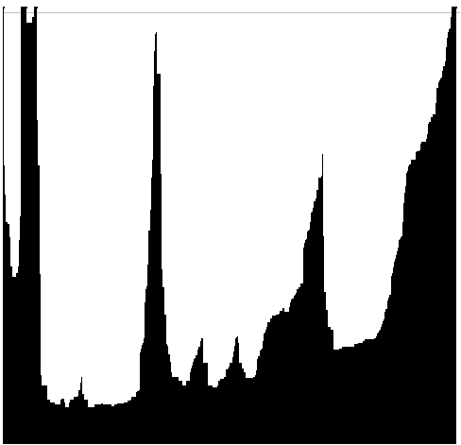
OPTICS: The Reachability Plot
represents the density-based clustering structure
easy to analyze
independent of the dimension of the data
reachability distance
reachability distance
cluster ordering
cluster ordering

Slide 63
OPTICS: Parameter Sensitivity
Relatively insensitive to parameter settings
Good result if parameters are just “large enough”
1
3
2
MinPts = 10, ε = 10
MinPts = 10, ε = 5
MinPts = 2, ε = 10
1
2
3
1
2
3
1
2
3

Slide 64
An Example of OPTICS
neighboring objects stay close to each other in a linear
sequence.
Reachability-distance
undefined
‘
Cluster-order of the objects

Slide 65
DBSCAN VS OPTICS
 | DBSCAN | OPTICS
Density | Boolean value (high/low) | Numerical value (core distance)
Density-connected | Boolean value (yes/no) | Numerical value (reachability distance)
Searching strategy | random | greedy

Slide 66
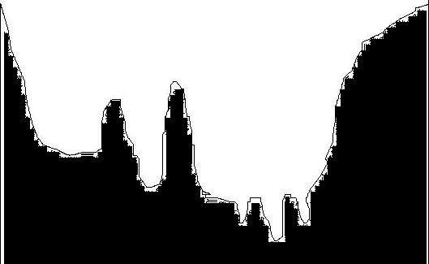
When OPTICS Works Well
Cluster-order of the objects

Slide 67
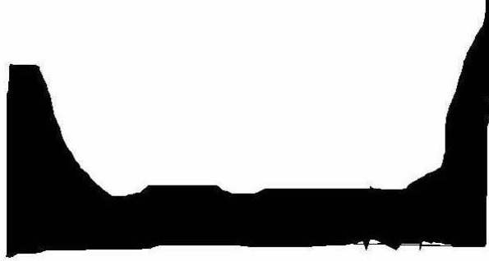
When OPTICS Does NOT Work Well
Cluster-order of the objects

Slide 68
DENCLUE: using density functions
DENsity-based CLUstEring by Hinneburg & Keim (KDD’98)
Major features
Solid mathematical foundation
Good for data sets with large amounts of noise
Allows a compact mathematical description of arbitrarily shaped clusters in high-dimensional data sets
Significantly faster than existing algorithm (faster than DBSCAN by a factor of up to 45)
But needs a large number of parameters

Slide 69
Denclue: Technical Essence
Model density by the notion of influence
Each data object exert influence on its neighborhood.
The influence decreases with distance
Example:
Consider each object is a radio, the closer you are to the object, the louder the noise
Key: Influence is represented by mathematical function

Slide 70
Denclue: Technical Essence
Influence functions: (influence of y on x, σ is a user given constant)
Square : f ^{y}_{square}(x) = 0, if dist(x,y) > σ,
1, otherwise
Guassian:

Slide 71
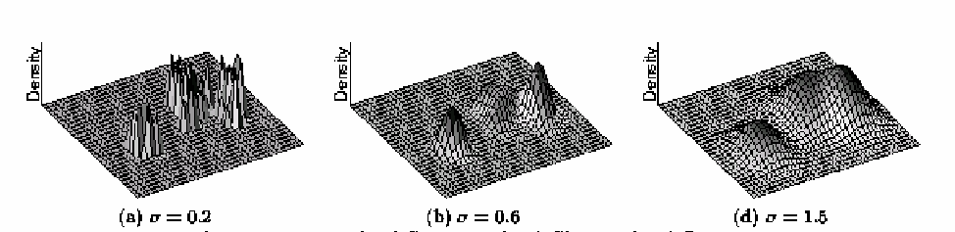
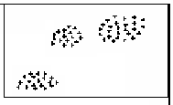
Density Function
Density Definition is defined as the sum of the influence functions of all data points.

Slide 72
Gradient: The steepness of a slope
Example

Slide 73
Denclue: Technical Essence
Clusters can be determined mathematically by identifying density attractors.
Density attractors are local maximum of the overall density function.

Slide 74
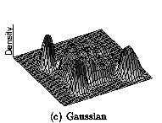
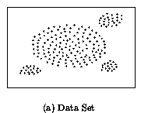
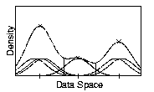
Density Attractor

Slide 75
Cluster Definition
Center-defined cluster
A subset of objects attracted by an attractor x
density(x) ≥ ξ
Arbitrary-shape cluster
A group of center-defined clusters which are connected by a path P
For each object x on P, density(x) ≥ ξ.

Slide 76

Center-Defined and Arbitrary

Slide 77
DENCLUE: How to find the clusters
Divide the space into grids, with size 2σ
Consider only grids that are highly populated
For each object, calculate its density attractor using hill climbing technique
Tricks can be applied to avoid calculating density attractor of all points
Density attractors form basis of all clusters

Slide 78
Features of DENCLUE
Major features
Solid mathematical foundation
Compact definition for density and cluster
Flexible for both center-defined clusters and arbitrary-shape clusters
But needs a large number of parameters
σ: parameter to calculate density
ξ: density threshold
δ: parameter to calculate attractor

Slide 79
CS4104 Applied Machine Learning
Hierarical Clustering

Slide 80
Clustering techniques
Hierarchical
Divisive/Top-Down
Agglomerative/Bottom-Up
Partitioned
clustering
Bayesian

Slide 81



Flat vs Hierarchical Clustering

Slide 82
Types of hierarchical clustering
Divisive (top down) clustering
Agglomerative (bottom up) clustering
Starts with all data points in one cluster, the root, then
Splits the root into a set of child clusters. Each child cluster is recursively divided further
stops when only singleton clusters of individual data points remain, i.e., each cluster with only a single point
The dendrogram is built from the bottom level by
merging the most similar (or nearest) pair of clusters
stopping when all the data points are merged into a single cluster (i.e., the root cluster)

Slide 83

Divisive hierarchical clustering

Slide 84

Agglomerative/Bottom-Up

Slide 85
Agglomerative/Bottom-Up
Single Link or Nearest neighbor
Complete Link or Farthest neighbor
Average Link or Centeroid distance

Slide 86
Single Link
Cluster 2
Cluster 1

Slide 87
Complete Link
Cluster 2
Cluster 1

Slide 88
Average Link
Cluster 2
c2
Cluster 1
c1

Slide 89


Divisive vs. Agglomerative
Divisive
Agglomerative
Faster

Slide 90
Assignment
Apply k-means clustering for k=3 on the provided data the first three points as a seed elements are:
seed1=Your_RollNumber%5
seed2=(Your_RollNumber%5)+2
seed3=(Your_RollNumber%5)+5
Element | X1 | X2
1 | 1 | 2
2 | 5 | 2
3 | 3 | 5
4 | 2 | 4
5 | 8 | 3
6 | 5 | 7
7 | 2 | 1
8 | 6 | 7
9 | 2 | 6
10 | 4 | 3
11 | 4 | 5
12 | 5 | 4

